Slide 1
BIOGRAPHY COVERS & POSTERS
Understanding the meaning and construction of book covers and film posters of biographies and autobiographies.

Slide 2
CONTEXT
Establishing the context in which a person’s story was produced and received before you begin deconstructing the use of codes in the book cover should help you to have a better understanding of the dominant meanings.
SUBJECT – what do you know about the subject of the biography? What are key ideas about their life might be presented?
TIME AND PLACE – when and where did the person live?

Slide 3
CONTEXT
PURPOSE – The purpose of a book cover is obviously to promote the book and suggest ideas about its subject that will encourage people to read it. What ideas in the cover suggest that it would be a good book to read?
TARGET AUDIENCE – Who would find the book relevant or interesting? What is in the cover that suggests the target audience? Who might react negatively or produce an alternative reading?
EMPHASIS – what area of life does the cover suggest the book will emphasise? What tells you this?
Is it funny or serious?

Slide 4
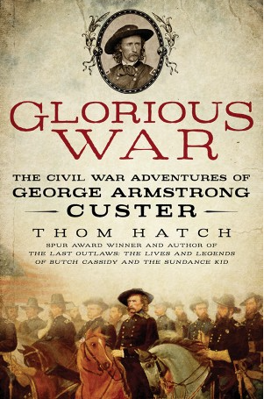


CONTEXT
What areas of life do these covers suggest the books will emphasise? What tells you this?

Slide 5
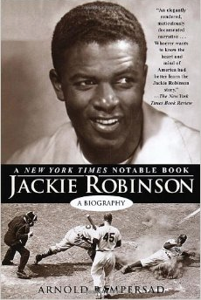
TECHNICAL
COMPOSITION – How are the objects or subjects arranged within the frame? What or who is:
in the centre?
at the edges?
in the fore, mid and back ground?
What relationships are shown?
What is emphasised by the ‘rule of thirds’?

Slide 6

TECHNICAL
FRAMING –
What is included and excluded by the framing?
Is an internal frame used?

Slide 7

TECHNICAL
BALANCE
Is the composition balanced?
If the image looks unbalanced what is creating this and for what effect?
FOCAL POINT (‘Hot Spot’)
To what point in the image is your attention drawn?
How is this achieved?

Slide 8

TECHNICAL
CAMERA DISTANCE AND ANGLE
What is the shot size and angle?
What effect do these have on the way you view the image?
How do these affect the way the subject is presented?

Slide 9

TECHNICAL
CAMERA DISTANCE AND ANGLE
What is the shot size and angle?
What effect do these have on the way you view the image?
How do these affect the way the subject is presented?

Slide 10

SYMBOLIC
OBJECTS
What objects are included in the frame?
What ideas might they represent that are relevant to understanding this image?

Slide 11

SYMBOLIC
OBJECTS
What objects are included in the frame?
What ideas might they represent that are relevant to understanding this image?

Slide 12

SYMBOLIC
CLOTHING
What does the clothing worn by the subjects reveal about them?
Is the clothing symbolic of a specific context or setting?

Slide 13

SYMBOLIC
CLOTHING
What does the clothing worn by the subjects reveal about them?
Is the clothing symbolic of a specific context or setting?

Slide 14

SYMBOLIC
BODY LANGUAGE
What can you infer about a subject through their body language?
Does body language reveal a relationship between subjects?
Is there a connection between a subject’s body language and what is occurring in the image?

Slide 15

SYMBOLIC
BODY LANGUAGE
What can you infer about a subject through their body language?
Does body language reveal a relationship between subjects?
Is there a connection between a subject’s body language and what is occurring in the image?

Slide 16

SYMBOLIC
LIGHTING AND SHADING
How does lighting contribute to the overall mood?
Is lighting used to emphasise certain areas, objects or subjects?
Are certain areas, objects or subjects in shadow?

Slide 17

SYMBOLIC
COLOUR
Are certain colours used because of their associated meanings?

Slide 18
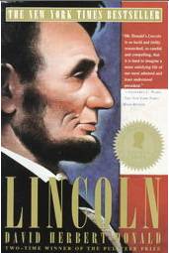
SYMBOLIC
COLOUR
Are certain colours used because of their associated meanings?

Slide 19
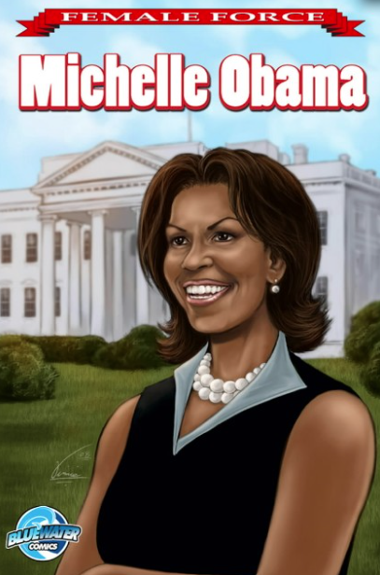
SYMBOLIC
SETTING
Is a setting visible? Is the setting a recognisable place?
Does the setting have associated meanings?

Slide 20

WRITTEN
FONT AND SIZE
Are certain words bigger or smaller than others?
Does the font relate to the subject matter?

Slide 21

WRITTEN
FONT AND SIZE
Are certain words bigger or smaller than others?
Does the font relate to the subject matter?

Slide 22
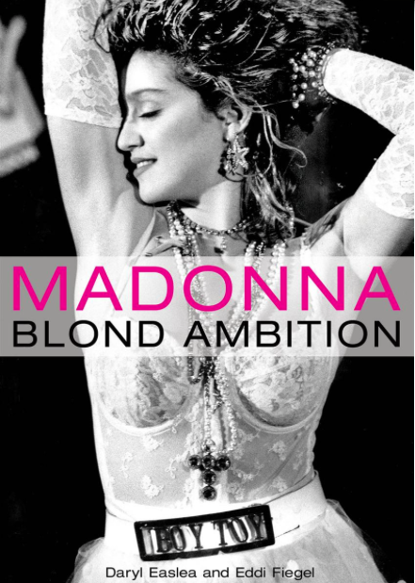
WRITTEN
INCLUSION
What are you able to read in the image?
Have signs, poster, written materials been deliberately included in the frame?
How does their inclusion relate to the image?
Does their inclusion influence the meaning made from the image?

Slide 23

WRITTEN
LANGUAGE CHOICE
Are connotative words used?
Are words with emotive appeals used?
How does the language attract the target audience?

Slide 24
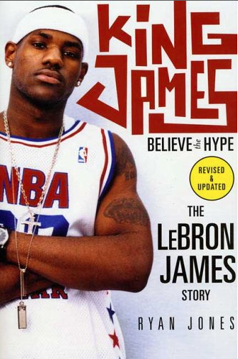
WRITTEN
TAG LINE A catchy and memorable phrase or sentence on a book cover.
An effective slogan should convey the mood, tone, and main idea of the biography without giving too much away.
It should capture readers' attention and make them interested in the story.

Slide 25
BIOGRAPHICAL VISUAL TEXTS
Examples:
film posters

Slide 26
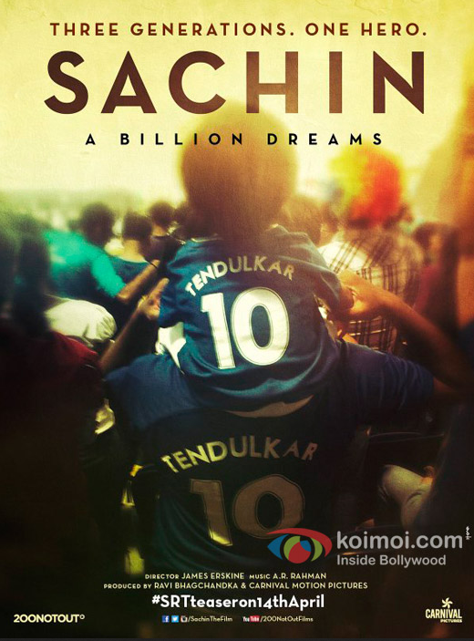

Slide 27


Slide 28
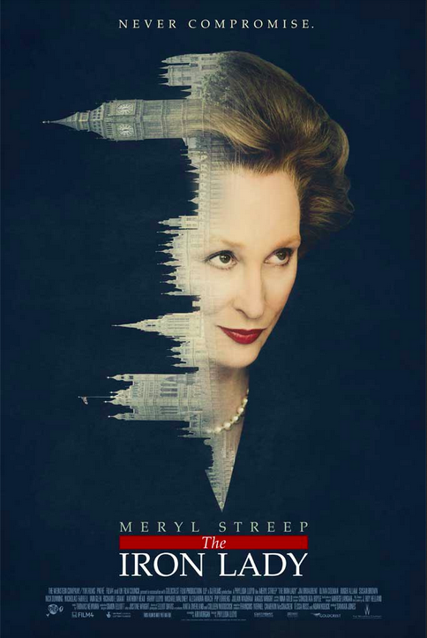

Slide 29
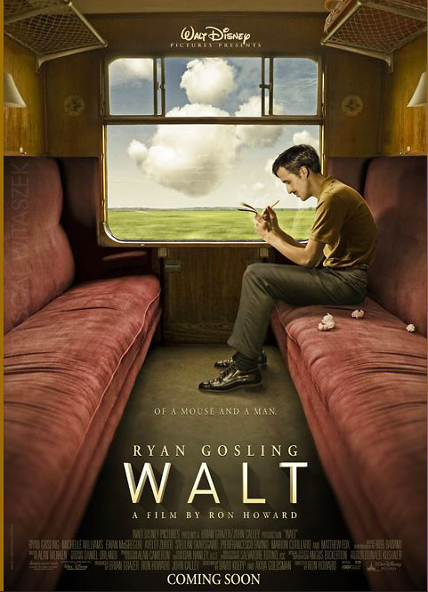

Slide 30
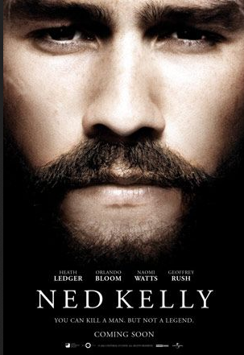

Slide 31


